Slide 1
Agenda 9/8
Questions?
A few updates
Online Collaboration Poll Results
Drawing Activity (without Computers)
Project 1: Generative Art
Intro to p5.js
Web-editor
Grid System
Shapes, Colors, Size, Rotate
In-class exercise #2

Slide 2
Updates
Electronic Art & Intermedia Open House Exhibition 10/21
Project Changes & Deadlines

Slide 3
Drawing Activity

Slide 4
Project 1: Generative Art
Due: 9/27 before class

Slide 5
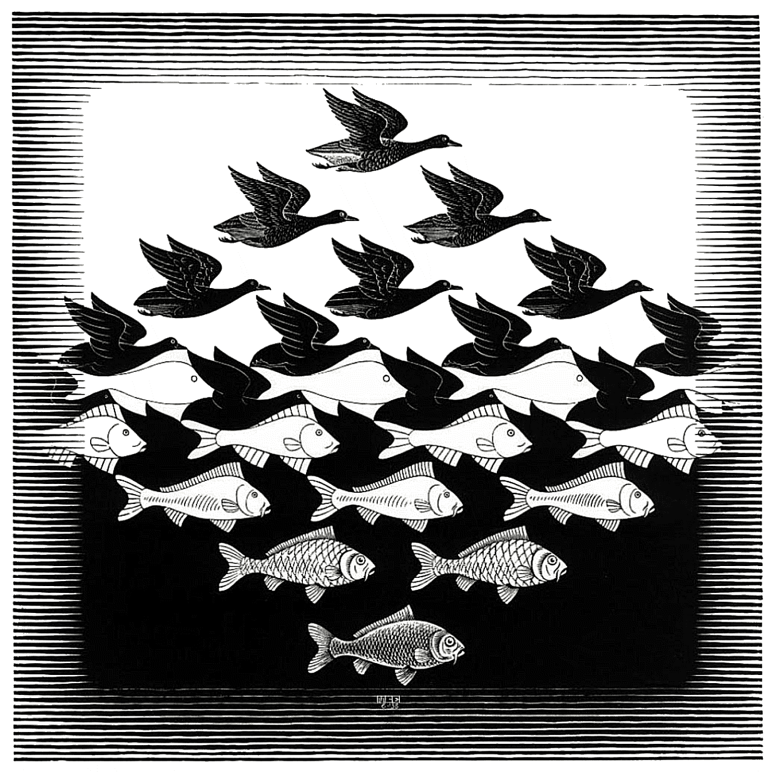
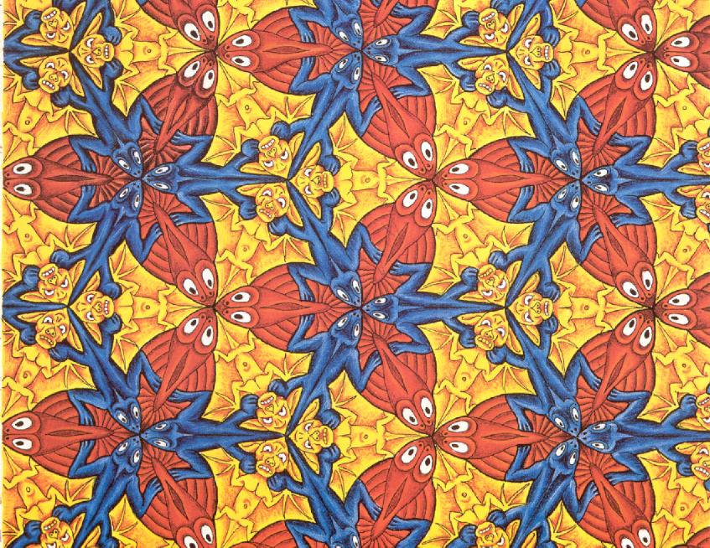
Inspiration
Escher – Tessellations

Slide 6
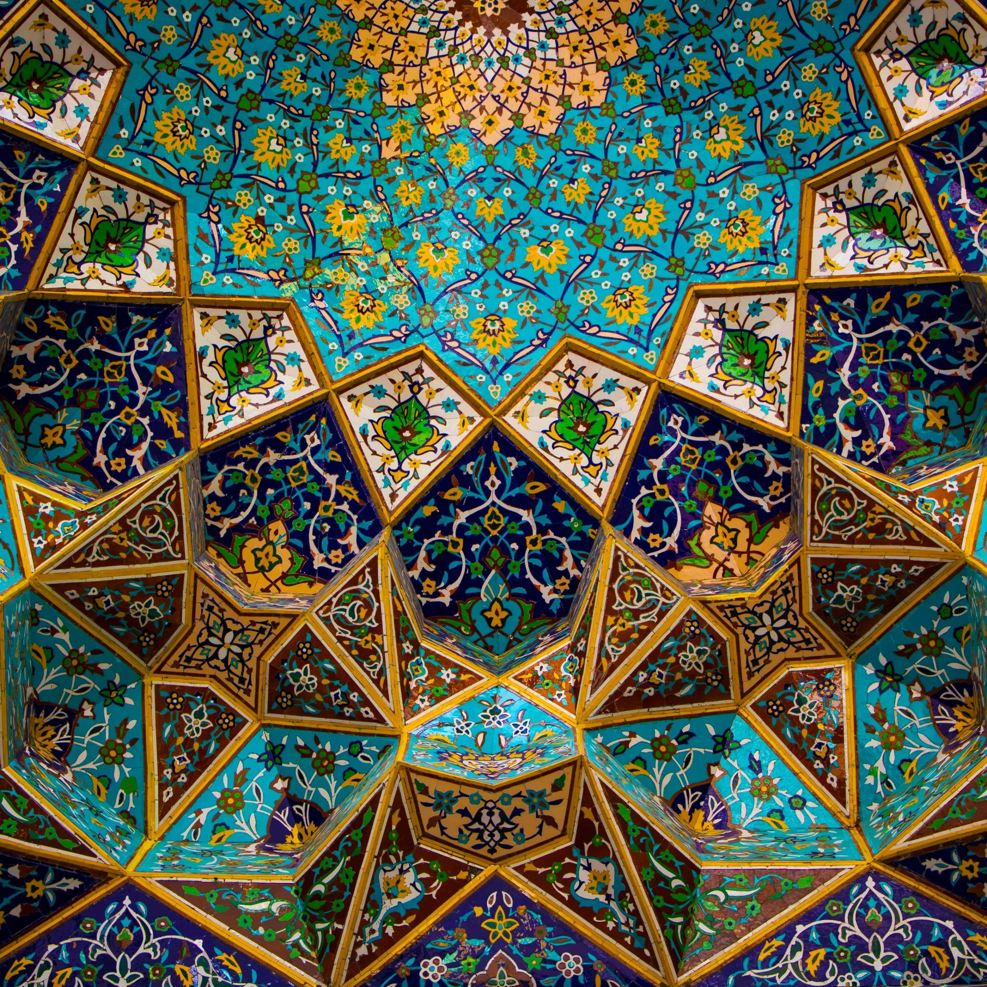
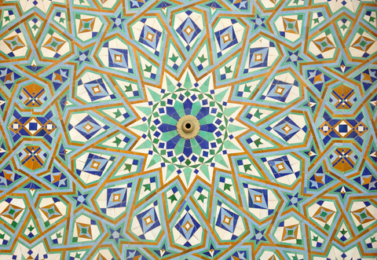
Inspiration
Islamic Art – Geometry & Patterns

Slide 7
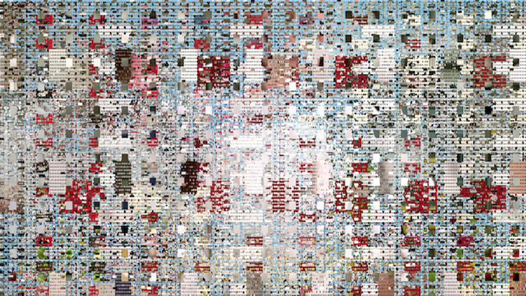
Inspiration
https://www.vice.com/en/article/9an9da/casey-reas-launches-new-exhibition-at-bitforms-gallery
Casey Reas

Slide 8
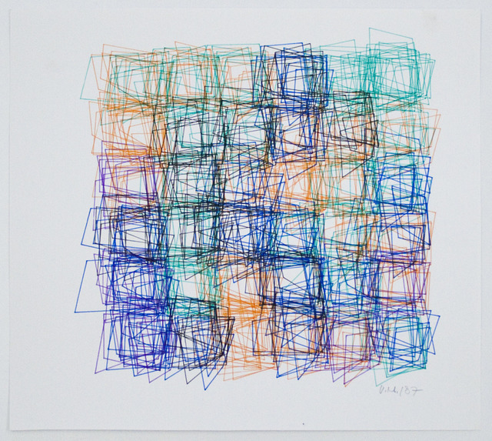
Inspiration
Vera Molnar

Slide 9
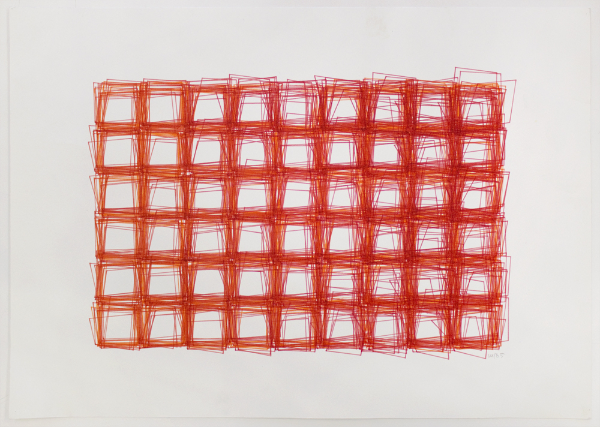
Inspiration
https://www.calvertjournal.com/articles/show/9879/this-new-york-exhibition-is-celebrating-hungarys-unsung-computer-art-pionee
Vera Molnar

Slide 10
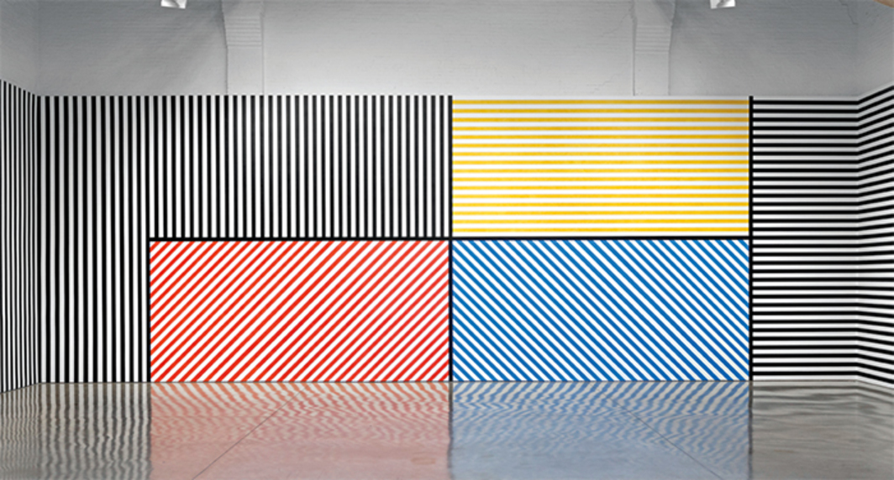
Inspiration
Sol LeWitt : Instruction Based Drawings

Slide 11
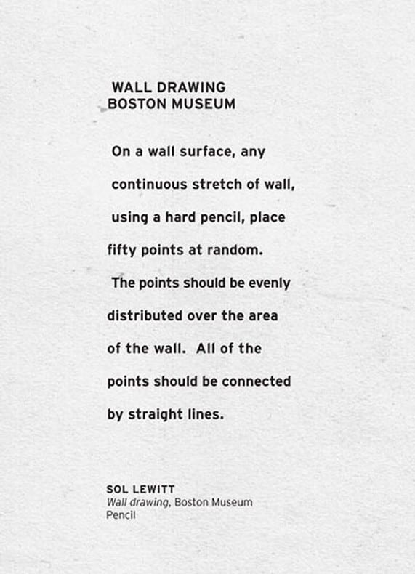
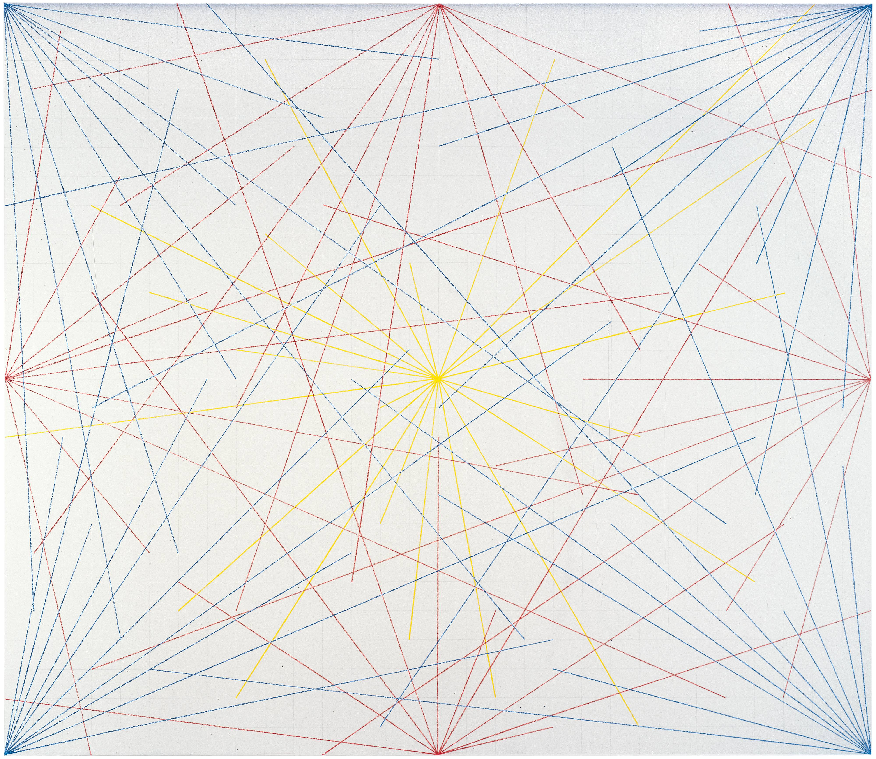
Inspiration
Sol LeWitt

Slide 12
p5.js web editor
Great way to save and share your sketches here:
https://editor.p5js.org/
Create an account now!
When submitting assignments, you can submit the link to your sketch
File > Share > Copy link to “Present”
Make sure to save your sketch first!

Slide 13
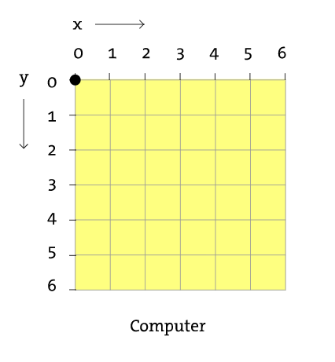
p5.js grid system
Pixels

Slide 14
p5.js Shapes…..but first
https://p5js.org/reference/ <- All you will ever need to know how to draw something!

Slide 15
p5.js Shapes
10, 20
rect(x, y, width, height) <- Has 4 arguments
X -> starting point of the square in x
Y ->starting point of the square in y
Width -> width of rectangle
Height -> height of rectangle
E.g.
rect(10, 20, 40, 30)
30
40

Slide 16
p5.js Shapes
Some shapes need more arguments
triangle(x1, y1, x2, y2, x3, y3)
x1 : x-coordinate of the first point
y1: y-coordinate of the first point
x2: x-coordinate of the second point
y2: y-coordinate of the second point
x3: x-coordinate of the third point
y3: y-coordinate of the third point

Slide 17
p5.js Shapes
Some shapes need less arguments
circle(x, y, d)
x : x-coordinate of the centre of the circle.
y : y-coordinate of the centre of the circle.
d : diameter of the circle.

Slide 18
p5.js Colors
Using fill before shape colors that shape
fill(r, g, b,a*)
r: red color range 0 -255
g: green color range 0 -255
b: blue color range 0 -255
a: alpha / transparency 0-255
fill(g,a*)
g: grayscale range 0 -255
a: alpha / transparency 0-255
* -optional

Slide 19
p5.js Colors
Try these other color commands
nofill()
stroke(
strokeWeight()
background()
colorMode()

Slide 20
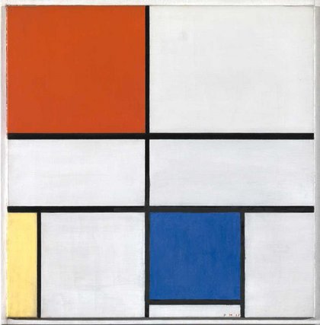
In-class exercise#2
Recreate Peit Mondrian’s Composition C (No.III) with Red, Yellow and Blue
Pro Tip: Use your sketch book!

